Slide 1




Raytracing simulations of observations with Parker Solar Probe/WISPR
Giuseppe Nisticò⁽¹⁾, Paulett Liewer⁽²⁾, Angelos Vourlidas⁽³⁾, Volker Bothmer⁽¹⁾, and Arnaud Thernisien⁽⁴⁾
⁽¹⁾ Institut für Astrophysik, Göttingen University, Germany
⁽²⁾ Jet Propulsion Laboratory, Pasadena, California, USA
⁽³⁾ APL, Johns Hopkins University, Maryland, USA
⁽⁴⁾ Naval Research Laboratory, Washington, DC, USA
3rd SoHe Meeting, 28-31 Oct 2018, Turin, Italy
Notes:
The work that I am going to present is made in collaboration with... and I am going to present the Parker Solar Probe mission, which of course has placed a lot
of expectations in the space and solar communities

Slide 2
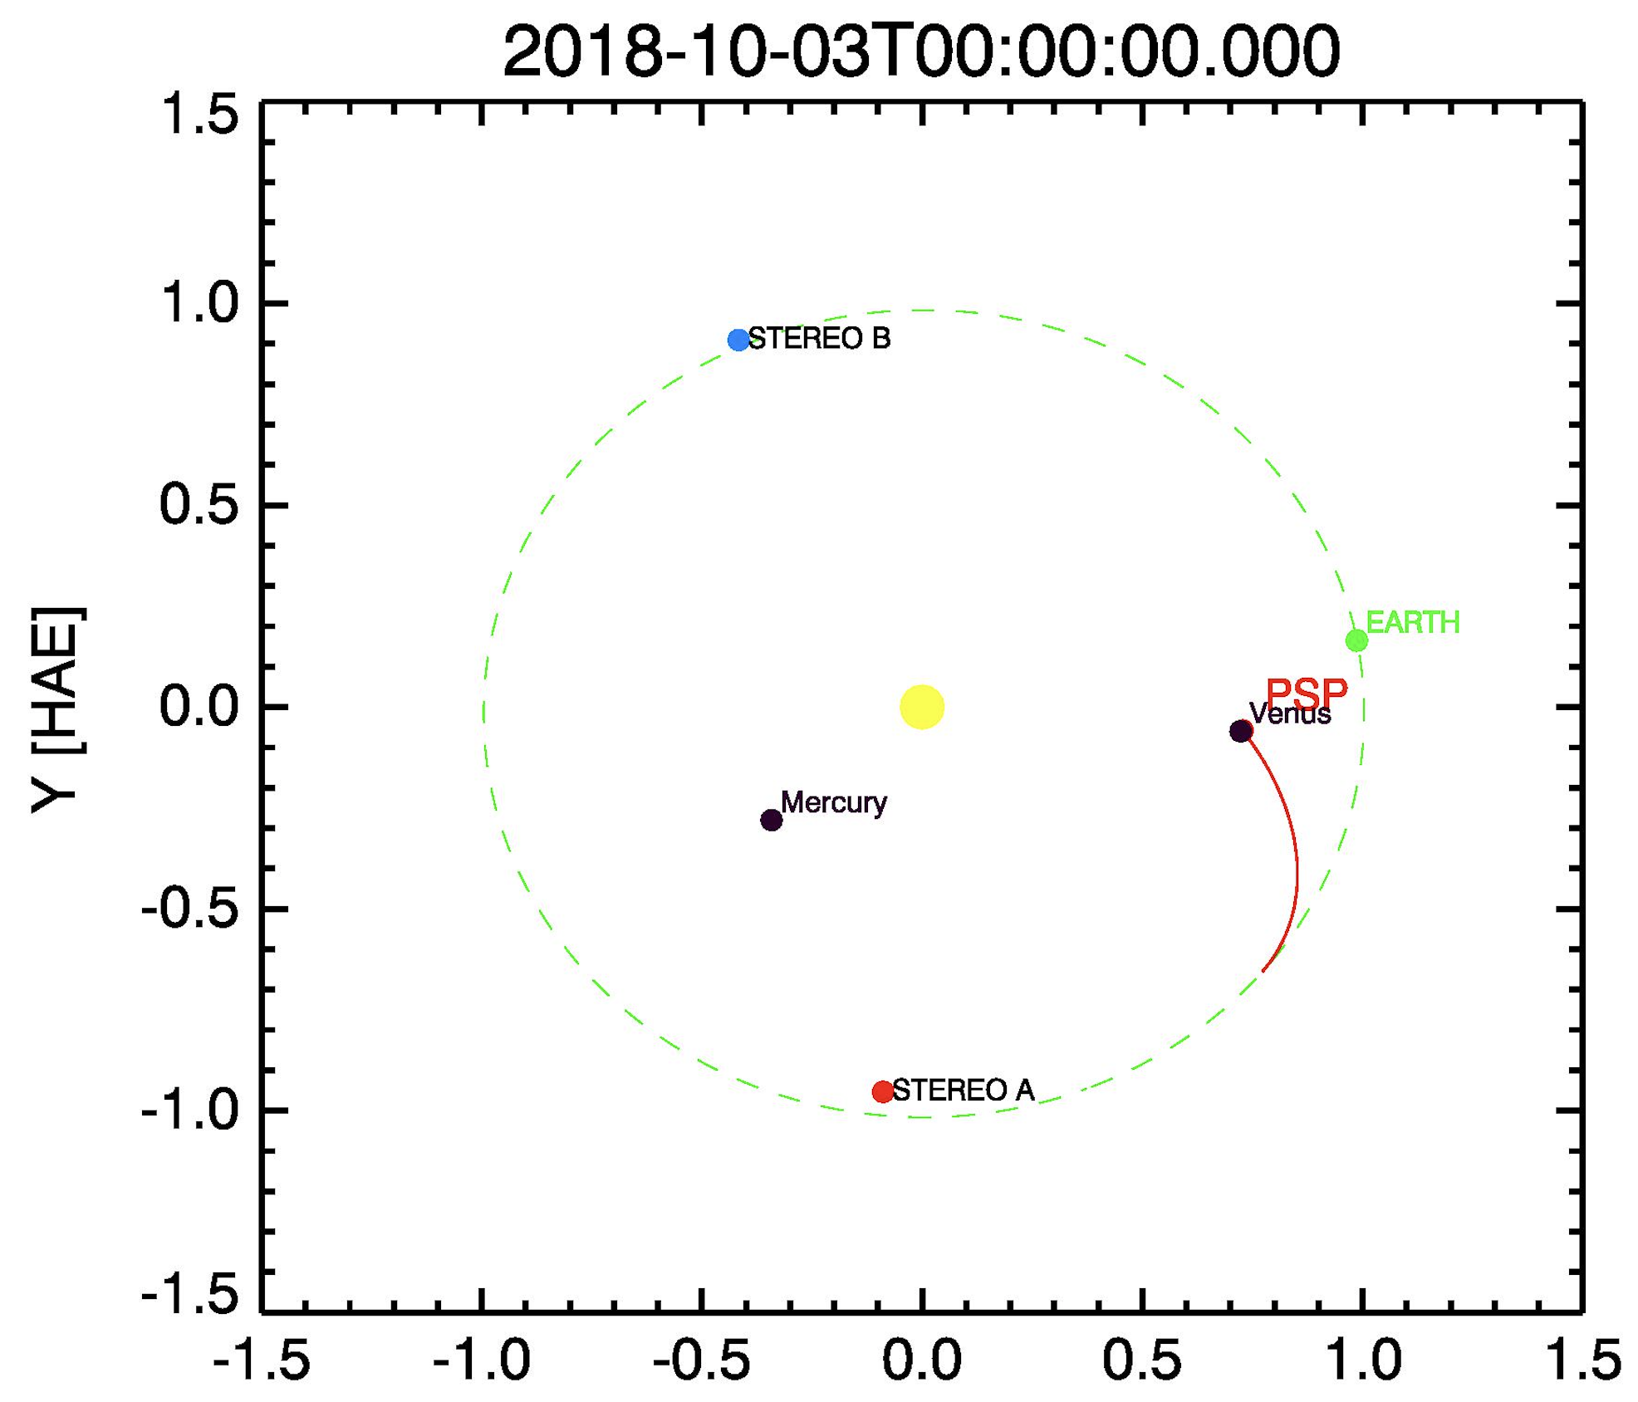
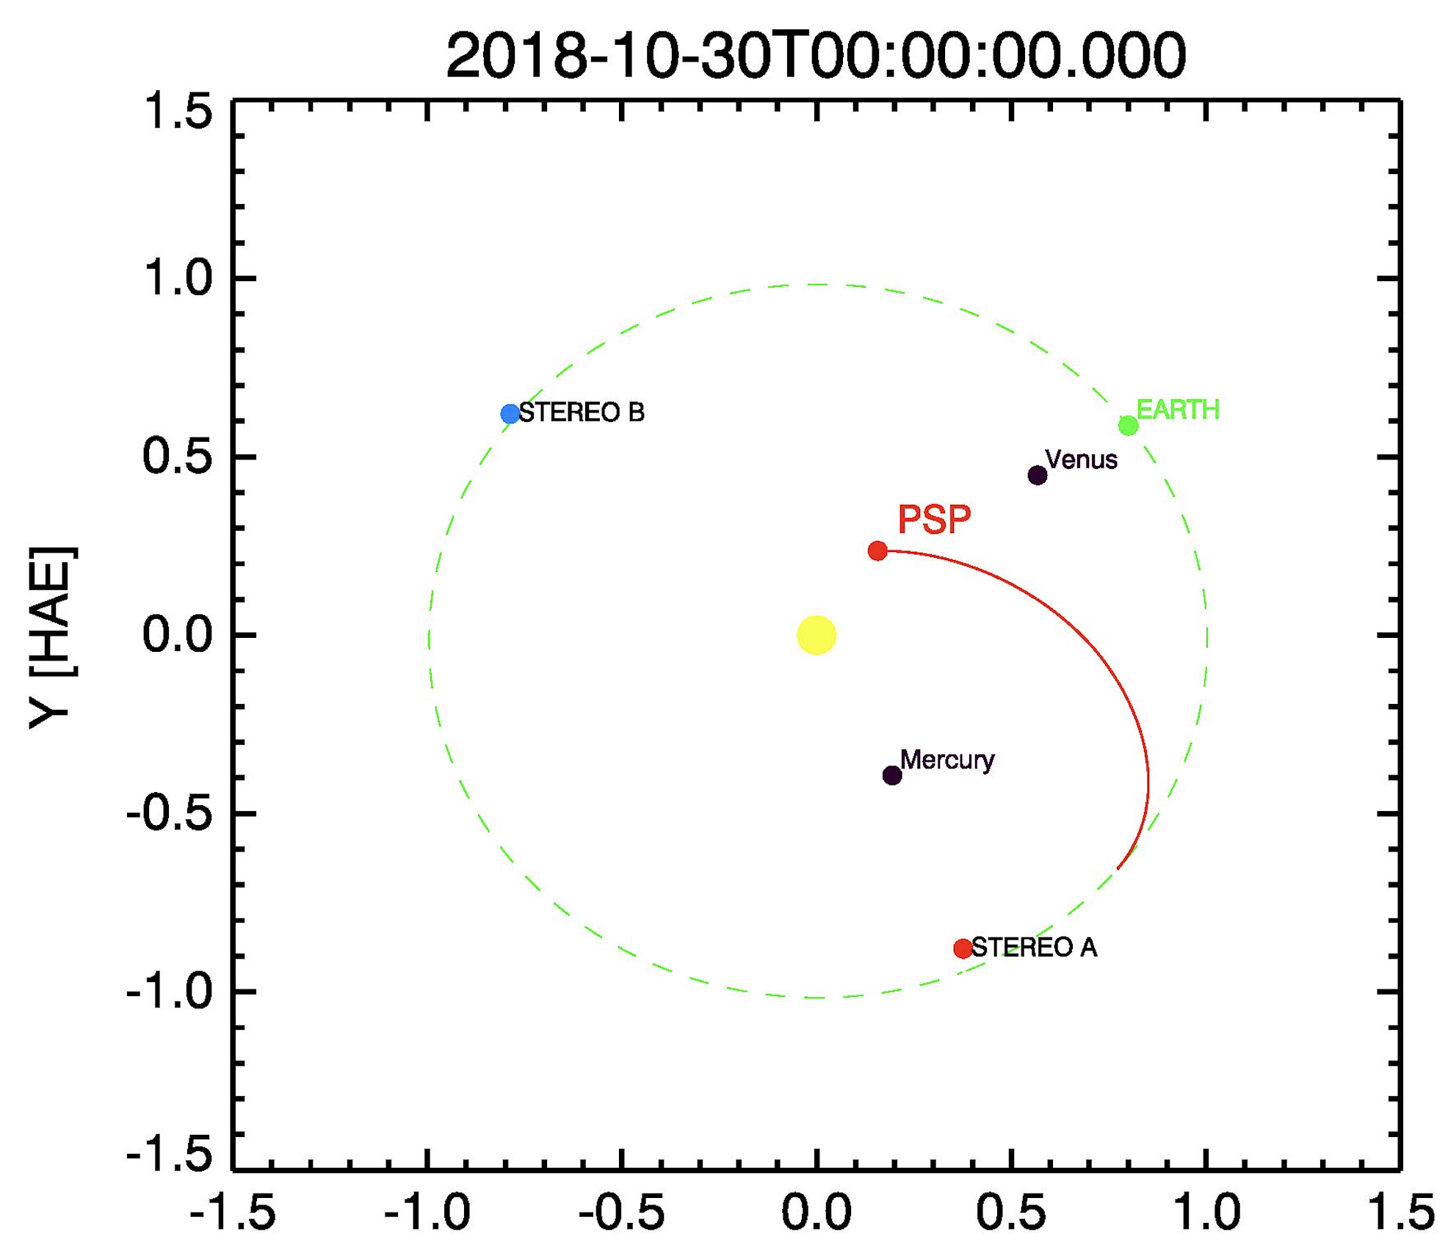
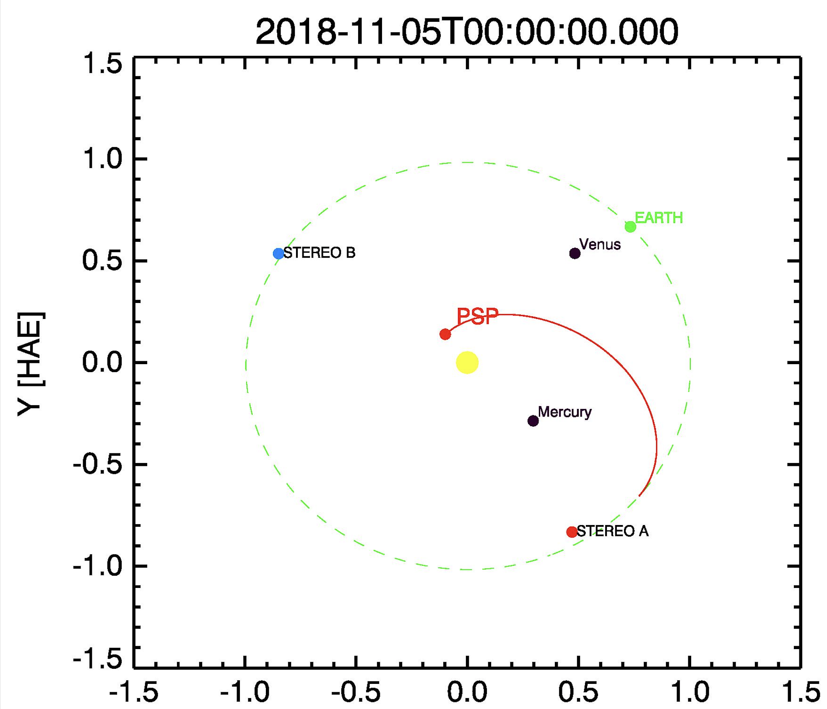
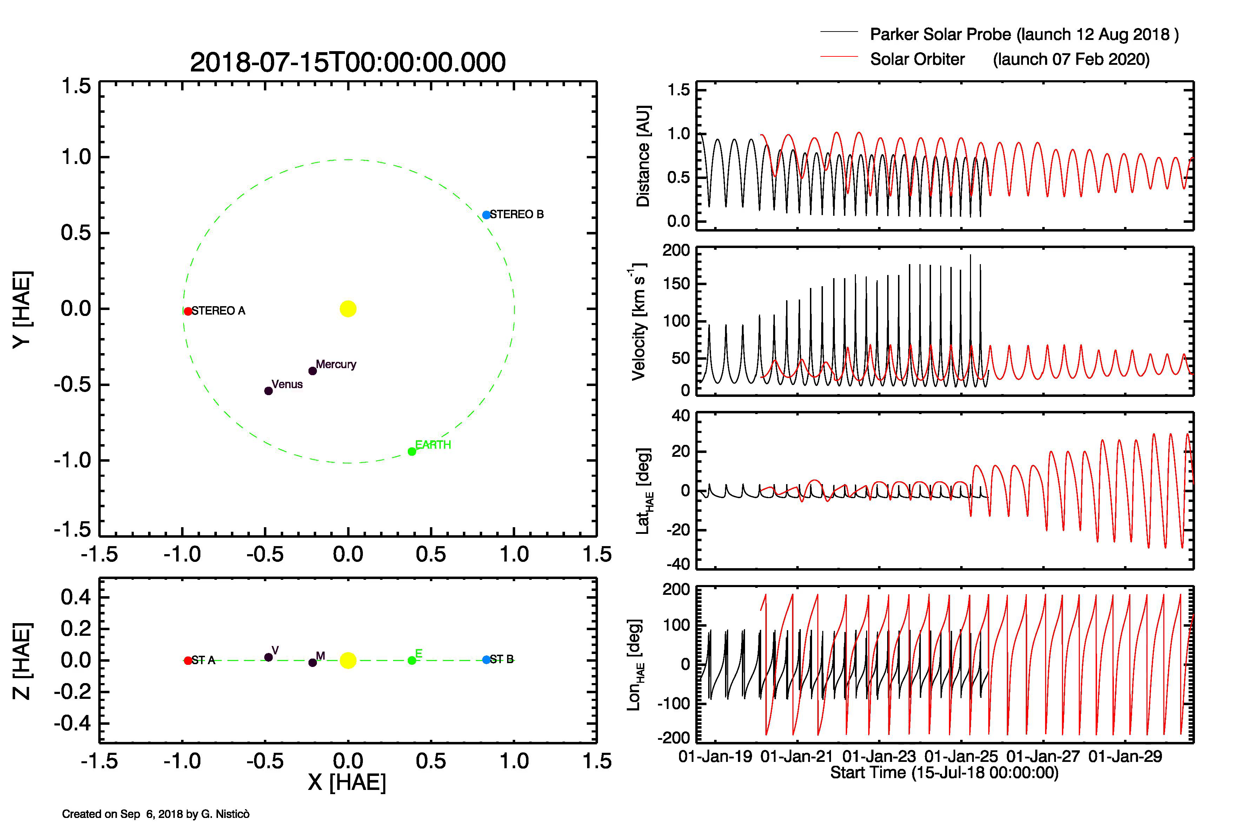
Notes:
Parker Solar Probe was launched in August, and has been injected into a orbit towards the Sun, by taking advantages of some gravity assists with Venus.
The first flyby of Venus was at the beginning of this month, now this is the current position and the spacecraft has started the first perihelion phase and collecting data,
data that will be collected and trasmitted to Earth during December. The peculiarity of Parker Solar Probe is its vicinity to the Sun during the perihelia, and will reach the minimum
distance below 10 solar radii later in 2024. On the other hand, it will explore and cross the near-Sun region with a high speed, about 200 km/s.

Slide 3
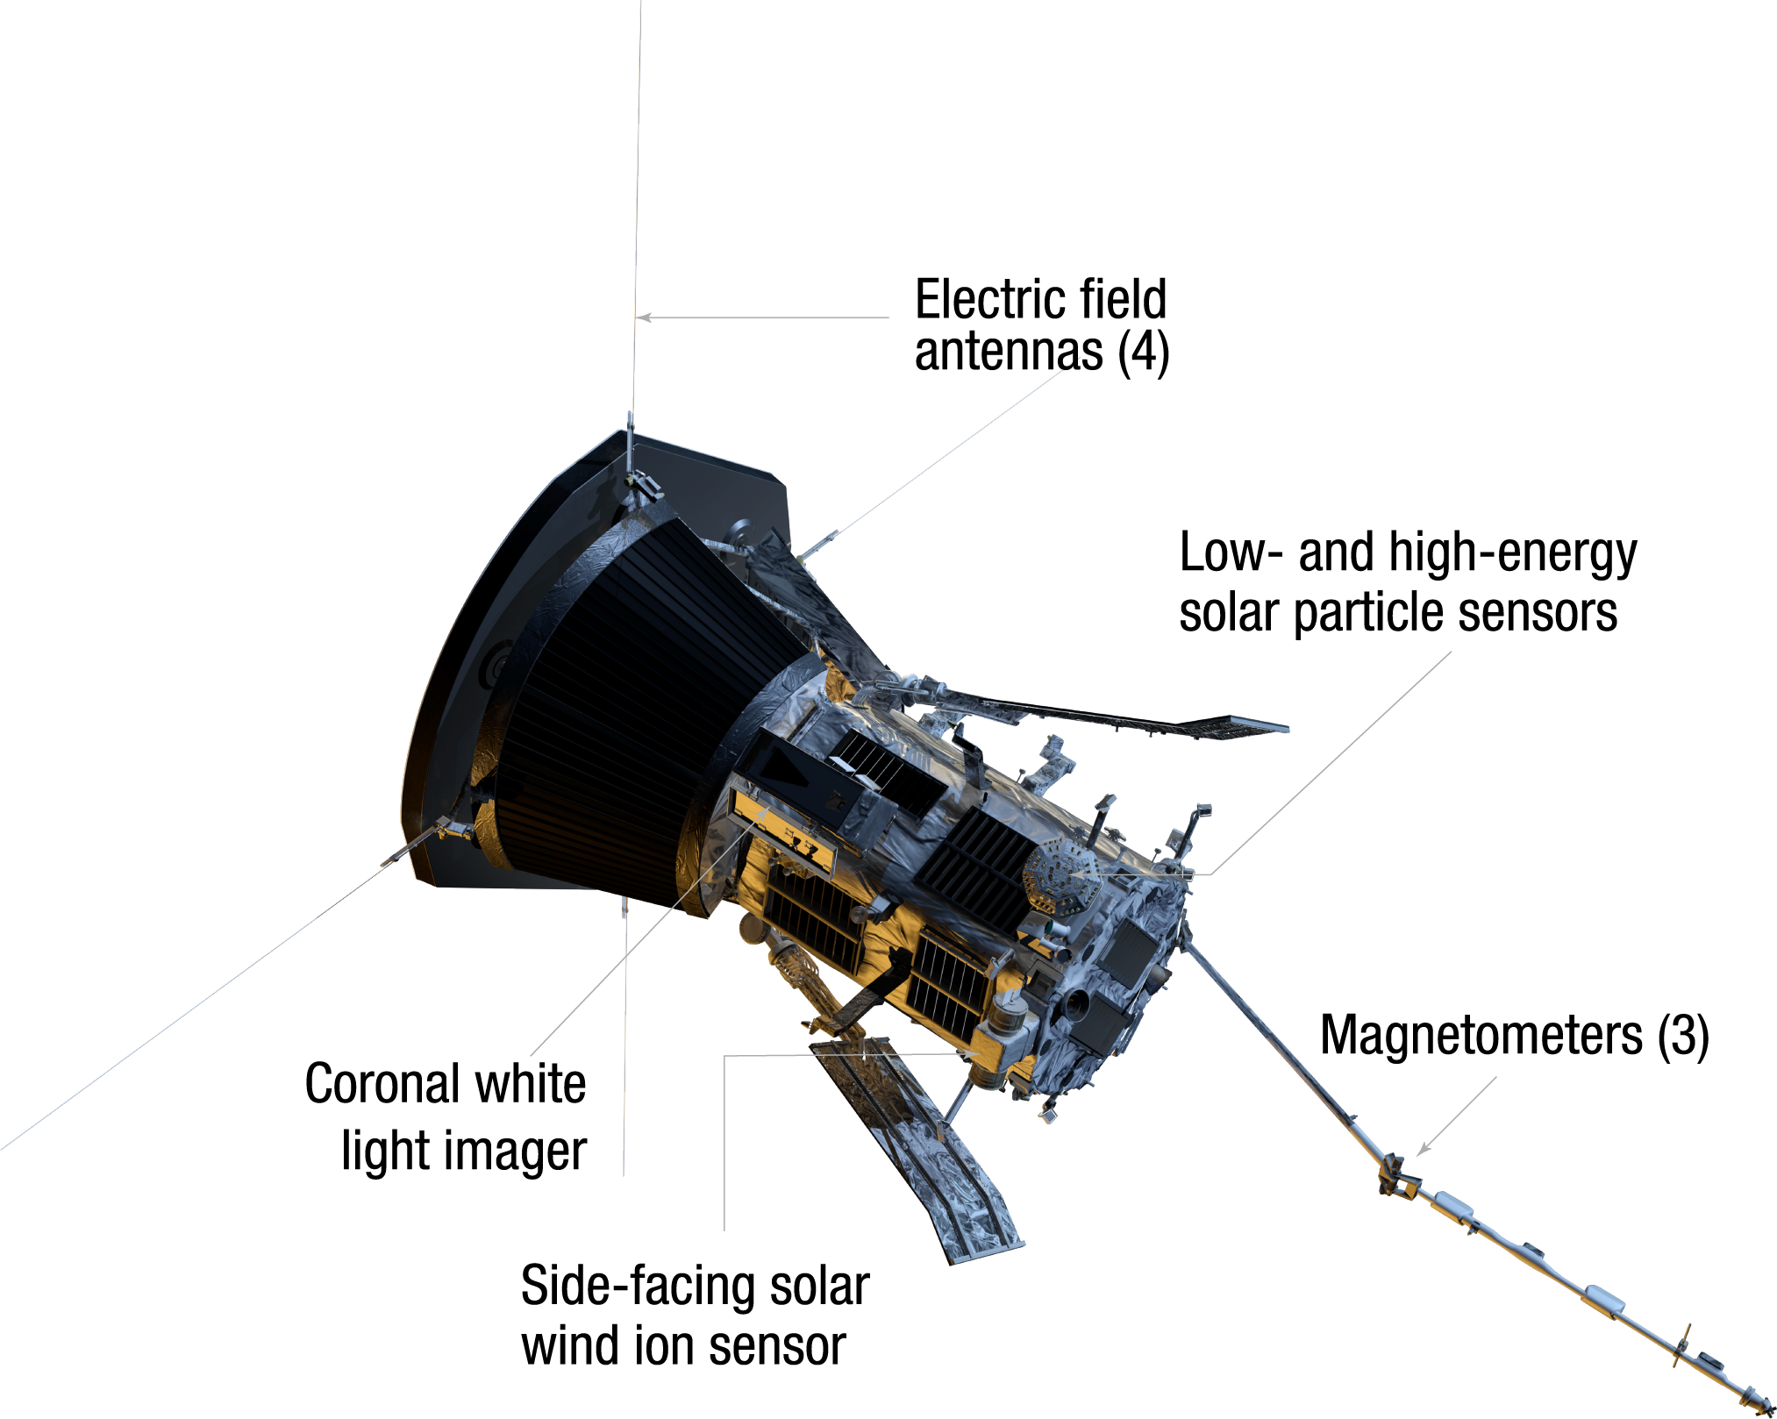
PSP’s instruments
Fields Experiment (FIELDS, Prof. S. Bale, University of California
Integrated Science Investigation of the Sun (ISIS, Dr. D. McComas, Princeton University)
Solar Wind Electrons Alphas and Protons Investigation (SWEAP, Prof. J. Kasper, University of Michigan/SAO)
Wide-field Imager for Solar PRobe (WISPR,Dr. Russel Howard, Naval Research Laboratory)
    WISPR-1
    WISPR-2
Notes:
The Probe is equipped with four instruments: 3 instruments taking in-situ measurements of the local plasma, that is magnetic field electrons, protons and alpha particles, and one optical instrument, called WISPR, which consists of 2 telescopes: one with a inner field of view, and the second one with an outer field of view.

Slide 4
PSP’s instruments
Fields Experiment (FIELDS, Prof. S. Bale, University of California
Integrated Science Investigation of the Sun (ISIS, Dr. D. McComas, Princeton University)
Solar Wind Electrons Alphas and Protons Investigation (SWEAP, Prof. J. Kasper, University of Michigan/SAO)
Wide-field Imager for Solar PRobe (WISPR,Dr. Russel Howard, Naval Research Laboratory)
    WISPR-1
    WISPR-2
(a) (b) (c)
Horizontal extention of the FoV in solar radii for WISPR-1 at the first perihelion in November 2018 (a), and at the perihelion in June 2024 (b). The plane of sky has been taken as a reference when converting angular distances to linear ones. The pixel size for WISPR-1 is showed in units of Mm (c).
Notes:
For the inner telescope I show here the FOV in solar radii projected onto the plane of sky at different dates. The lines represents the inner (left) and outer (right) edges of the images. The third plot show plate scale of the instrument converted into Mm.

Slide 5
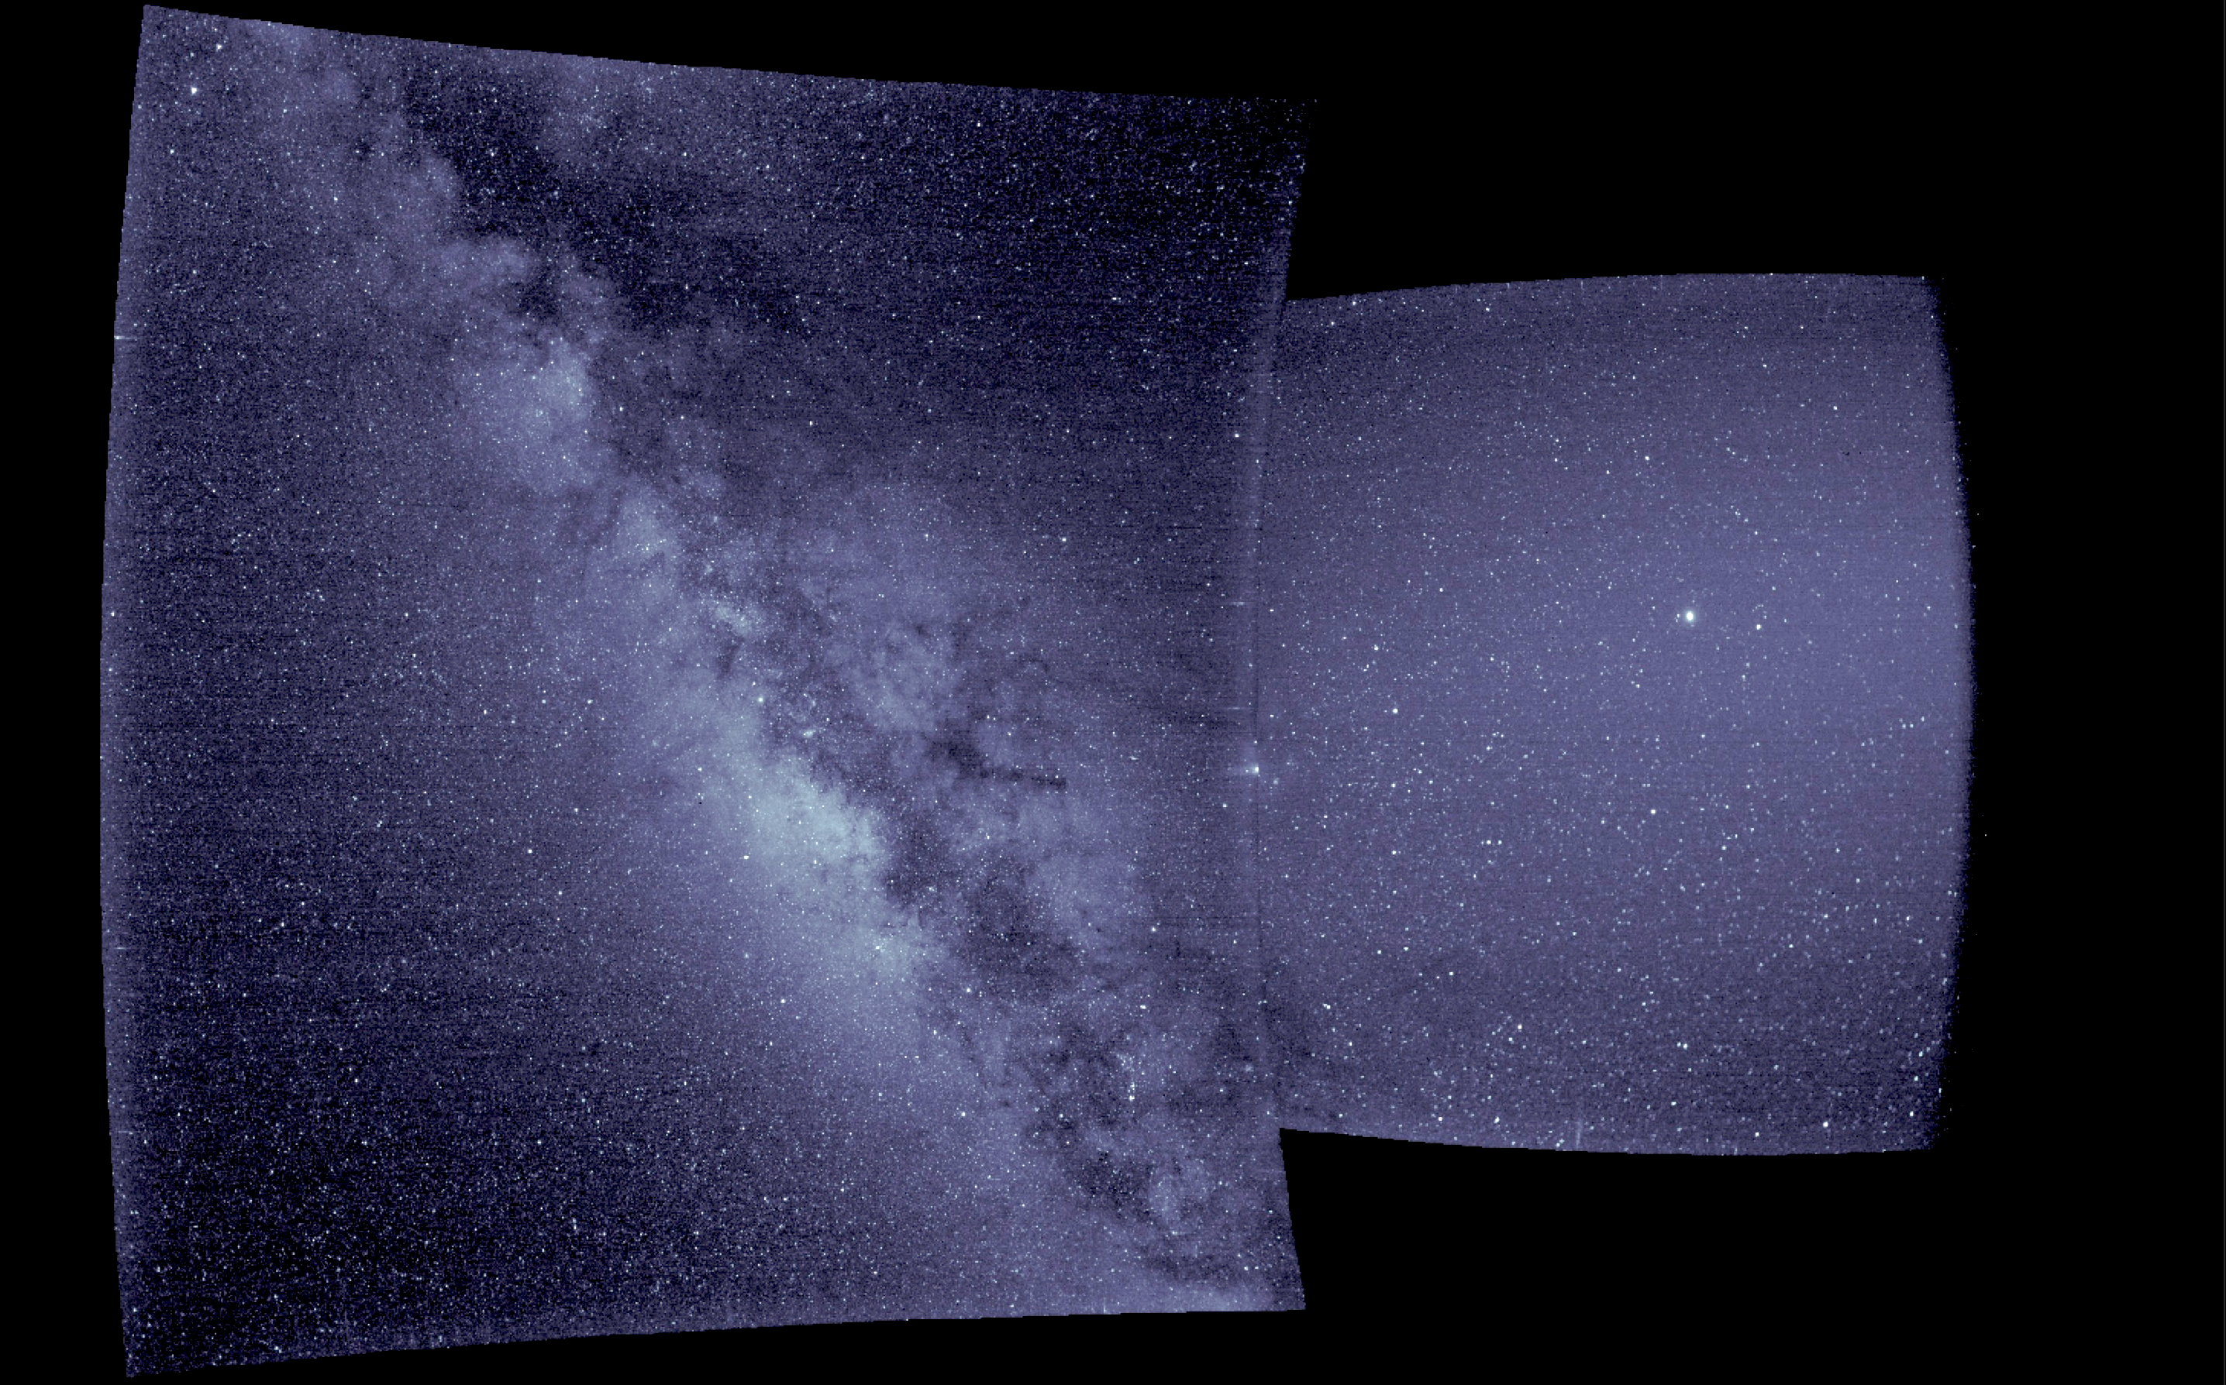
WISPR’s first light (9 Sept 2018)
(http://parkersolarprobe.jhuapl.edu/News-Center/Show-Article.php?articleID=101)

Slide 6
WISPR’s science objectives
Understanding the morphology, velocity, acceleration, density of solar wind structures close to the Sun (e.g. CMEs, shocks, turbulence);
Deriving the 3D structure of the solar corona;
Complementing the in-situ measurements of the solar wind and coronal plasma.
Motivations
Anticipating WISPR observations by simulating synthetic white-light images;
Studying the effects of PSP’s orbit on the observed coronal structures (e.g. change in the relative distance, spatial resolution, total brightness).
Building the basis for 3D geometry reconstruction
Development of a widget tool to simulate WISPR images. The widget is based on the following SSW packages: raytracing software, SUNSPICE, WCS
Notes:
The science objectives concern the understanding of the solar wind properties, acceleration, and the investigation of the 3d structure of the solar corona. In addition, WISPR will complement in-situ measurements, since PSP will cross coronal structures that will be first observed. In order to get prepared to WISPR data analysis, it is important to anticipate the observations and try to understand the effects of PSP‘ orbits on the WISPR images. Therefore, we have developed a widget tool based on some SSW packages in order to simulate WISPR data.

Slide 7
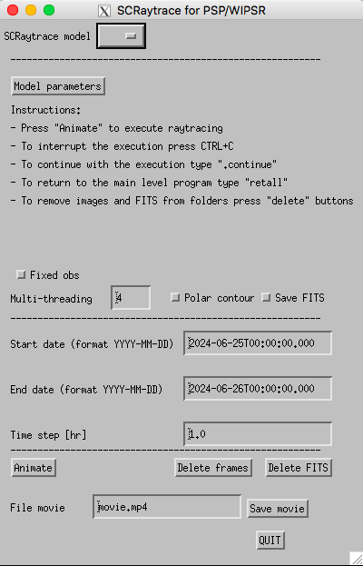
WISPR’s science objectives
Understanding the morphology, velocity, acceleration, density of solar wind structures close to the Sun (e.g. CMEs, shocks, turbulence);
Deriving the 3D structure of the solar corona;
Complementing the in-situ measurements of the solar wind and coronal plasma.
Motivations
Anticipating WISPR observations by simulating synthetic white-light images;
Studying the effects of PSP’s orbit on the observed coronal structures (e.g. change in the relative distance, spatial resolution, total brightness).
Building the basic for geometrical 3D reconstruction
Development of a widget tool to simulate WISPR images. The widget is based on the following SSW packages: raytracing software, SUNSPICE, WCS
Notes:
The science objectives focus on the understanding of the solar wind properties, acceleration, and the investigation of the 3d structure of the solar corona. In addition, WISPR will complement in-situ measurements, since PSP will cross coronal structures that will be first observed by WISPR.

Slide 8
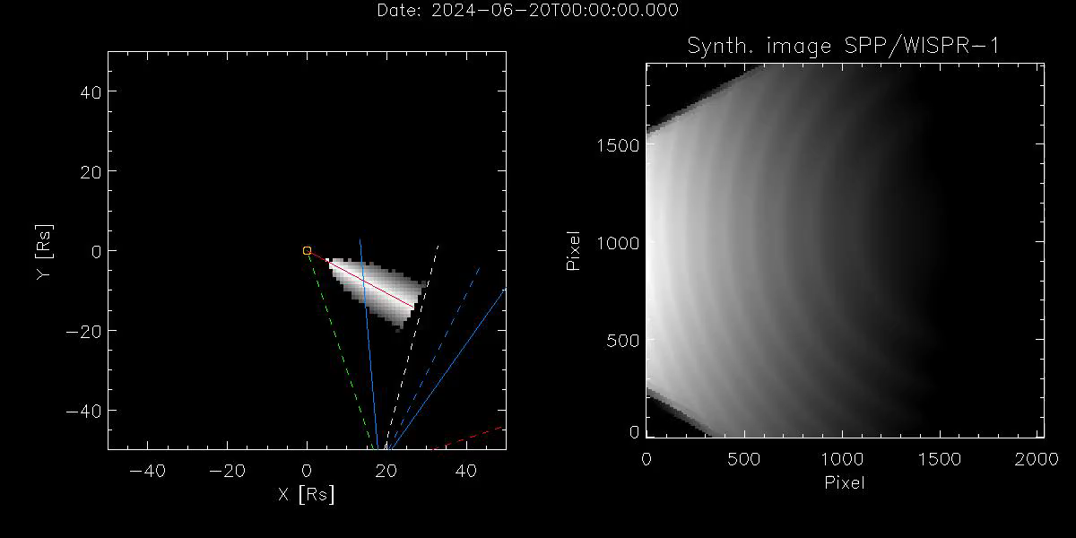
Slab streamer observed by PSP/WISPR 1
Notes:
This is an example of a slab streamer observed by WISPR. The Streamer is connected to the solar surface and rotaing with the Sun. This is a very simple example. As you can see, so far I have not considered the background, and other things...

Slide 9
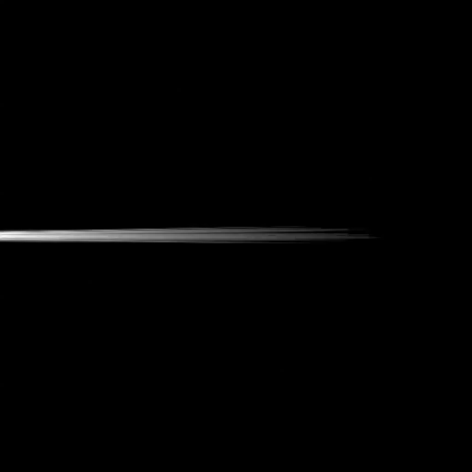
Simulation of a structured streamer (Paulett Liewer)
2nd science orbit covering a time span of 120 hrs before perihelion to 20 hrs after
Notes:
A better example is given in this simulation by Paulett Liewer showing a highly structured streamers, the details of which are resolved when the spacecraft gets
closer to it.

Slide 10
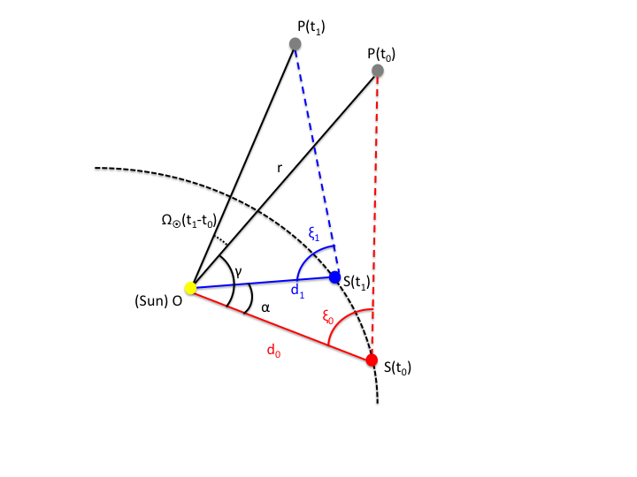
Geometrical triangulation for a point co-rotating with the Sun (orbital plane appoximation)
Notes:
A first problem is connected to the understanding of the 3D position of an observed structure. Here I show a simplification of this problem, We considered a structure P located on the orbital plane of PSP, and corotating with the Sun.

Slide 11
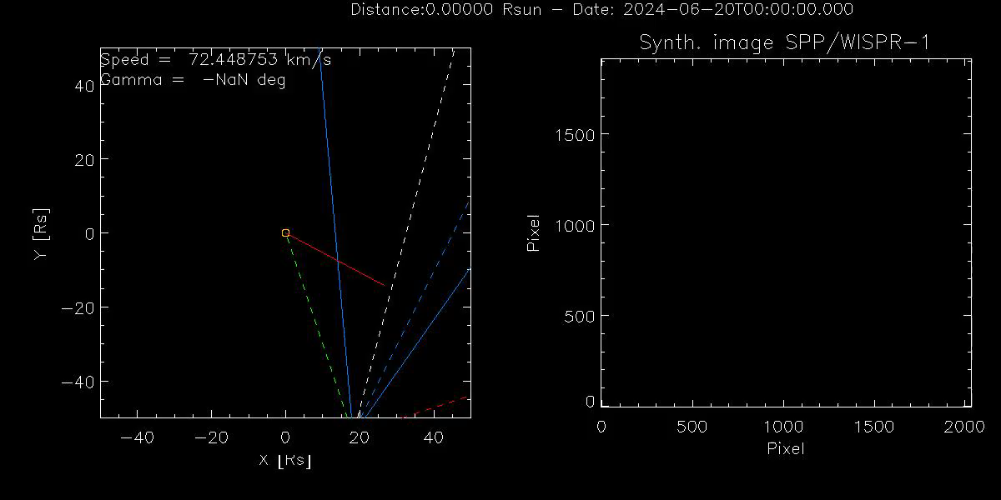
Simulation of a plasma blob moving away from the Sun with v= const

Slide 12
J-map

Slide 13
Geometrical triangulation for a point moving radially from the Sun (orbital plane appoximation)
Notes:
If we consider generic triangles and analogously to the previous case, we come up with an expression of the elongation as a function of time with some parameters to be defined.
The plot here shows the elongations profiles for a blob moving with constant speed, departing from 1 solar radius, and moving radially at different heliocentric longitudes. The dashed lines include the WISPR FoV. However, these profiles are not unique.

Slide 14
Geometrical triangulation for a point moving radially from the Sun (orbital plane appoximation)
Notes:
Indeed, if we consider a speed of 850 km/s, the elongation profiles, represented by the coloured dashed lines, are different, but some of these coincide with some lines of the previous plot: for example, the profile at 110 deg of longitude is in practise the same of that with a speed of 100 km/s and longitude of 90 deg. Therefore, there is a very huge difference in speed. We need to consider another observation, in addition to the measured elongations

Slide 15
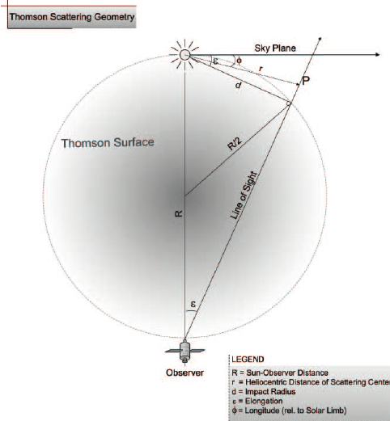
Study of the brightness profile
The Thomson scattering emission depends on the geometrical configuration between the scattering source and the observer
(Vourlidas & Howard 2006)
Notes:
We take into account the total brightness, which should vary according to the position of the observed and the emitting source. The geometrical configuration is changing over time because of the PSP orbit. Intrinsically, the Thomson scattering depends on the density and column depth of the structure, ist distance from the Sun, and the scatter angle xi. We didi some test by keeping the density and column depth constant, and chaning the radial distance of the structure, and chekck how the scatter angle chi influences the total brightness profile.

Slide 16
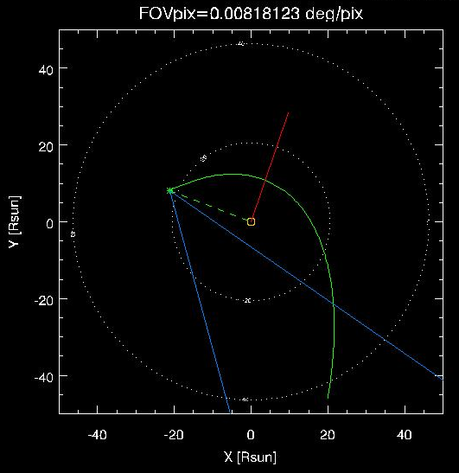
Stationary blob at a constant radial distance from the Sun
No variation of the distance of the structures from the Sun.
Notes:
We consider a series of blob located at the same distance from the Sun and different heliocentric longitudes. We have taken the profile at 0. deg of longitude as a reference, and correct the other by the factor (1-cos2 chi)

Slide 17
Stationary blob at a constant radial distance from the Sun
No variation of the distance of the structures from the Sun.
The differences in the profiles are due to the variation of the scatter angle χ .
Notes:
The matching is perfect! The are just small difference due to the fact that we are dealing with a structure of finite size (1 solar radius).

Slide 18
Blob moving radially with constant speed from the Sun
Manual fit of the profiles
[1] (dashed lines)
[2] (continuous lines)
To better determine position and speed of a structure, total brightness and elongations profiles should be fitted simultanoeusly.
For small scatter angles, the contribution from the factor
can be neglected, and we can use Eq. [1]
to model the total brightness trend.
Notes:
Similar approach for the blobs moving with constant speed. The dashed lines show the manual fits by considering the only factor r-2, which increases in time since the blob are moving away from the Sun. The continous lines are are corrected by the scatter angle factor.

Slide 19
Fitting analysis of associated total brightness and elongation
Blob moving with v=50 km s⁻¹, and lon=90 deg
We manually sample the Jmap track, and extracted the total brightness from each data point. The data points were fitted with the MPFIT routines in IDL.
Total brightness vs. time fit -> determination of the speed v
Elongation vs. time fit -> determination of the initial distance r₀ and γ ( v fixed)

Slide 20
Conclusions
We developed a widget tool to simulate PSP/WISPR data with the raytracing software
We built the basis for 3D reconstruction with WISPR
Elongation and total brightness measurements are required to fully determine the kinematic status (position, speed) of an observed structure
Ideally, simultaneous minimization of the elongation and total brightness curves would be necessary (Monte Carlo, Bayesian techinques)
A 2-step fitting procedure allows for reliables estimates of position and speed
The widget tool can be adapted to simulate data of the coronagraph METIS and the heliospheric imager of Solar Orbiter, and to plan joint observations with Parker Solar Probe

Slide 21
Thanks for your attention!

