Slide 1

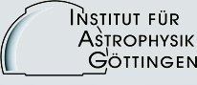
Ray-tracing modeling of coronal structures for PSP/WISPR
Giuseppe Nisticò
P. Liewer, V. Bothmer, A. Vourlidas,
and thanks to A. Thernisien
SoloHI/WISPR Science Consortium Meeting, 21 Feb 2018
Hampton Inn, National Harbor, MD
Notes:
Good morning. Today I am going to show some very simple simulations of images from WISPR.
The work is made in collaboration with...

Slide 2
Main purpose
To anticipate future PSP/WISPR data by simulating observations of coronal structures
Notes:
The main purpose is to anticipate observations that will be accomplished by WISPR.
What I shown here is a plot of the extension of the WISPR FoV for the inner camera during the perihelions
PSP in 2024. When we did this by converting the angular Fov , which extends for 40 deg, into solar radii at the
observed plane of sky. The lower line would represent the inner limit of the FoV, and the outer line the outer bounday.
Therefore, we will be able to observe down to a distance of about 3 solar radii, and having the chance to study
Stuctures like hermelt streamers, coronal funnerls, or also CMEs, maybe erupting prominences, and jet-like phenomena.
In addition, it is useful for the study of the solar wind, the distance of 12 solar radii where the solar wind is supposing to
move from a sub-alfvenic to a superalfvenic state, as well as wave-like associated phebomena and turbulence.

Slide 3
Main purpose
To anticipate future PSP/WISPR data by simulating observations of coronal structures
Helmet streamers, coronal funnels
CMEs, jets, prominences
Wave phenomena
Notes:
The main purpose is to anticipate observations that will be accomplished by WISPR.
What I shown here is a plot of the extension of the WISPR FoV for the inner camera during the perihelions
PSP in 2024. When we did this by converting the angular Fov , which extends for 40 deg, into solar radii at the
observed plane of sky. The lower line would represent the inner limit of the FoV, and the outer line the outer bounday.
Therefore, we will be able to observe down to a distance of about 3 solar radii, and having the chance to study
Stuctures like hermelt streamers, coronal funnerls, or also CMEs, maybe erupting prominences, and jet-like phenomena.
In addition, it is useful for the study of the solar wind, the distance of 12 solar radii where the solar wind is supposing to
move from a sub-alfvenic to a superalfvenic state, as well as wave-like associated phebomena and turbulence.

Slide 4
Strategy:
Development of IDL routines exploiting existing packages in SSW.
  SUNSPICE for the PSP trajectory (position, speed)
  The World Coordinate Systems (WCS) to define the coordinates for the image and simulate a WISPR FITS header (also based on a typical STEREO-HI data)
  Raytracing tool for the solar corona (Thernisien et al. 2004)
    https://hesperia.gsfc.nasa.gov/ssw/stereo/secchi/idl/scraytrace/doc/
    Several models are implemented in the packages (flux ropes, helmet streamers, plasma spheres, cylinders, ...)
Notes:
So, the strategy that we used in our work: we developed some IDL routines by exploiting exisiting packages in SSW, in particular:
SUNSPICE to get info on the state of PSP, that is its position, speed
The WCS package to simulate the coordinate system for the WISPR images and define a WISPR FITS header, (which is for our purpose based on a typical STEREO HI header )
And finally the raytracing tools developed by Thernisien and co-authors, which implements several to model to simulated the Thomson scattering emissions of flux ropes, streamers,
Currents, sheets, etc.

Slide 5
Steps followed
1) Definition of the characteristics of WISPR image data
Image: 2048 x 1920 pixels
Elongation FoV: [40,40] deg
Offset: starting from 13.5 deg
Pixel size: 40 deg/ 2048 px = 0.019 deg = 70.31 arcs (at the Sun)
2) SUNSPICE
Getting the position of PSP from the SPICE kernel
cspice_furnsh, kernel
Defining the state of PSP
state = GET_SUNSPICE_LONLAT( t_utc, id, system = 'HEEQ', /meters, /degrees)
The ID for PSP is -180731
State is a vector containg the radial distance from the Sun, the heliographic longitude and latitude
Notes:
In the next two slides I give a summary of the IDL procedures used, just to give you an idea. First we start from the characteristics
Of the WISPR image, at least for the camera 1.
The angular resolution is about 70 arcsec, which corresponds to a certains amount in km, depending on the distance of PSP from the Sun.
From SunSPice, we define the physical state of the probe. With this call we get radial distance , and the heliographics coordinates.

Slide 6
3) Construction of a WCS structure
wcs = wcs_2d_simulate(wispr.pixel[0], wispr.pixel[1], cdelt = wispr.elongation_fov[0]/wispr.pixel[0], dsun_obs=state[0], date_obs=t_utc, hgln_obs=state[1], hglt_obs=state[2], cunit=deg, crval = [ wispr.offset[0] + 0.5*wispr.elongation_fov[0], 0.], projection='AZP' )
4) Construction of the FITS header
hdr = wcs2fitshead(wcs, /struct)
We used a typical STEREO-HI FITS header to define other tagnames
5) Raytracing
rtraytracewcs,sbt,imsize=imsize,modelid=58,$
scchead=hdr,losnbp=500,losrange=[0,200], /frontinteg,$ modparam=param, nbthread=8,nbchunk=8
Notes:
Then we move to define the coordinates sistem of the WISPR images by simulating the wcs structure of a 2D data.

Slide 7

Example 1: slab streamer observed by PSP/WISPR 1
(model 14)
Link to the movie
Notes:
This is the simulation of a coronal funnel, model number 14. This model
Slab model with density
Sphericaly symmetric Ne
//!
//! Use the Hayes model
//! - Ne(r)=Sum_k alpha_k * r^(-k) , k=1,2,3,4
//! - Orthoradial model : exp(-d^2/w0(r)) and exp(-abs(d/u0(r)))
//! - with w0(r) = Sum_k beta_k * r^(-k)), k=1,2,3,4

Slide 8
Example 1: slab streamer observed by PSP/WISPR 1
(shorther time range)
Notes:
This is another movie about the same structure but with 10 days of observations at the perihelion and a temporal resolution of 1 hr.
So far, we are not perfectly reproducing the behaviour of WISPR, since the cadence of the instruments during the perihelion phase
will be under 1 min. Here, just because of computation time, I am showing some images with a cadence of 1 hr

Slide 9
Example 2: plasma cylinder (model 16)
Notes:
This is another movie about the same structure but with 10 days of observations at the perihelion and a temporal resolution of 1 hr.
So far, we are not perfectly reproducing the behaviour of WISPR, since the cadence of the instruments during the perihelion phase
will be under 1 min. Here, just because of computation time, I am showing some images with a cadence of 1 hr

Slide 10
Simulation of a sphere of plasma imaged by PSP/WISPR 1
(model 58)
Coordinates: r ~15 solar radii, lat=0, and lon=270 deg in the HCI reference frame.
Speed = 0 km/s

Slide 13
J-map

Slide 14
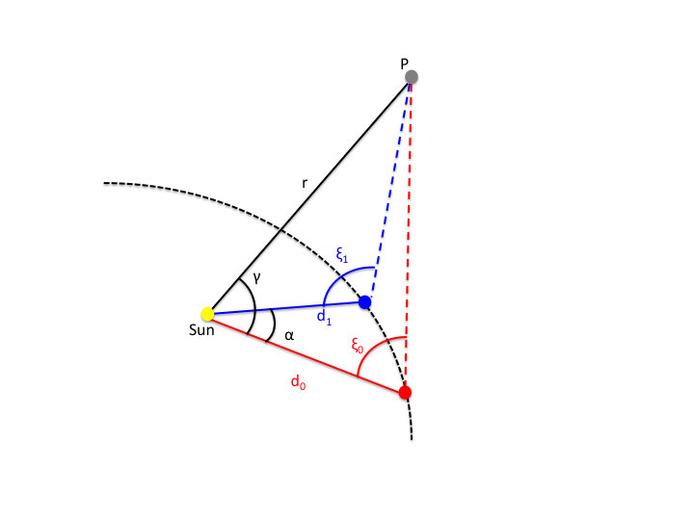
Determination of the 3D position for a fixed point in space
Let us consider the triangles 0S(t₀)P and OS(t₁)P. Because of the law of sines:
O
S(t₁)
(Liu et al 2010, ApJ.)
S(t₀)

Slide 15
Determination of the 3D position for a fixed point in space
Determination of the azimuthal angle (measured with respect to the position S(t₀))
This is equivalent to the determination of the longitude
O
S(t₁)
S(t₀)

Slide 16
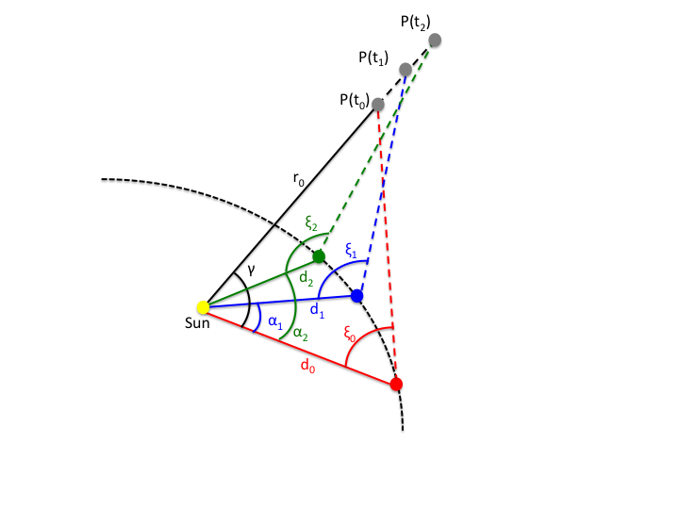
Determination of the 3D positions for a point moving radially with uniform speed
3 unknown variables: r₀,γ, v

Slide 17
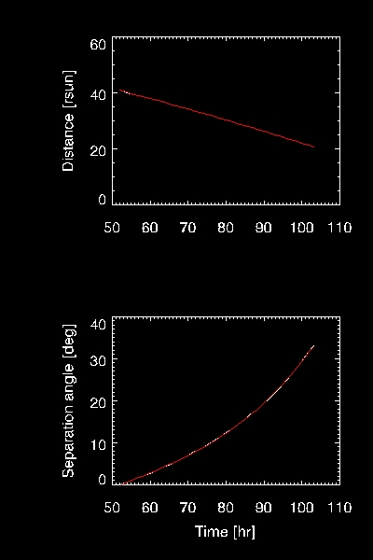
Fitting function
We used MPFIT routines, which provide a robust and relatively fast way to perform least-squares curve fitting (Markwardt et al. 2009)

Slide 18
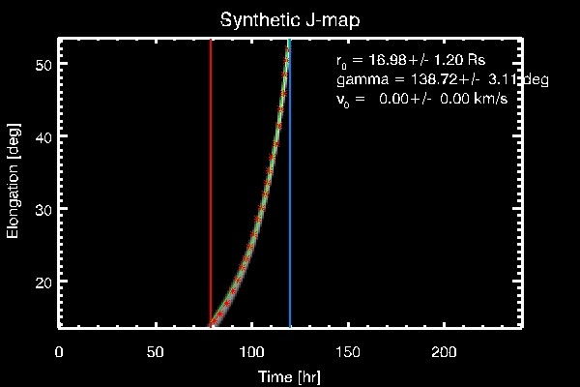
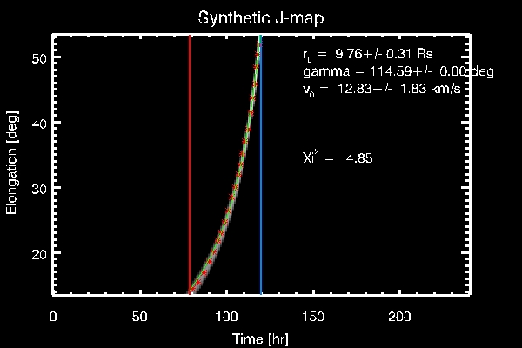
Fitting analysis
Case: plasma sphere at rest
← Speed constant
← Speed as free parameter to be determined

Slide 19
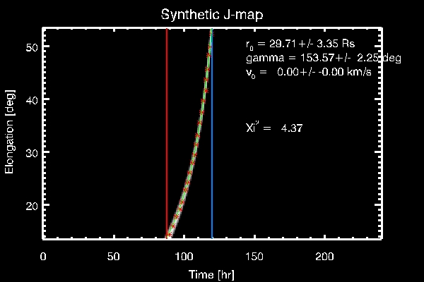
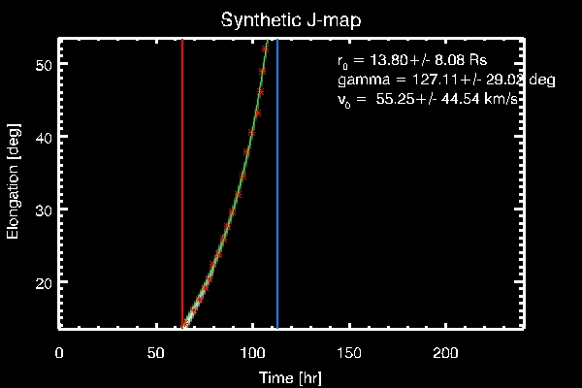
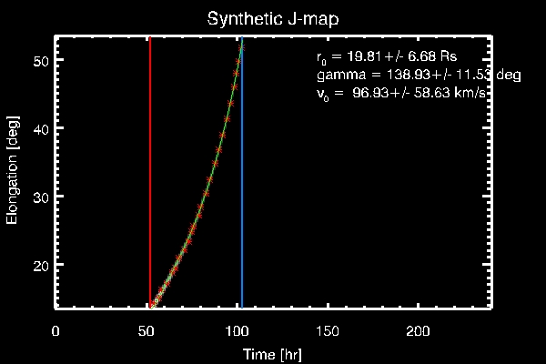
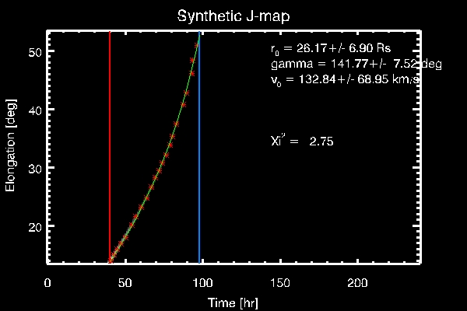
Speed ≈ 24 km/s
Speed ≈ 72 km/s
Speed ≈ 121 km/s
Speed ≈ 241 km/s

Slide 20
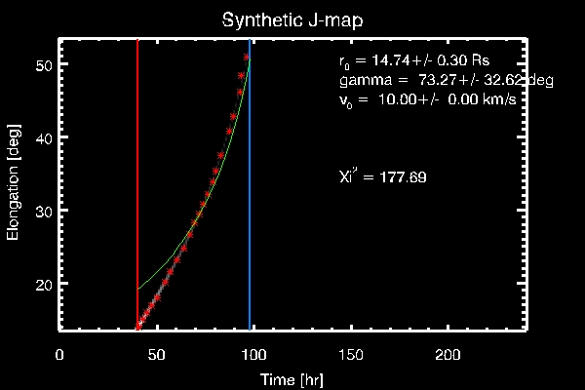
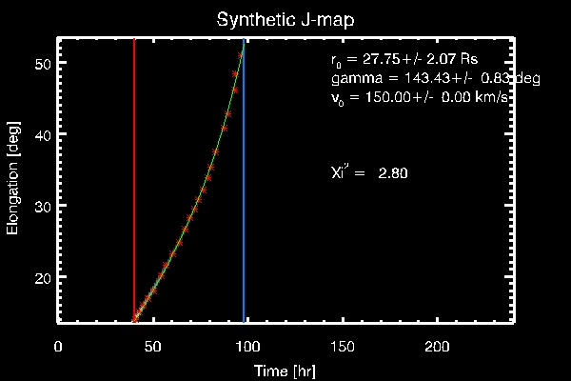
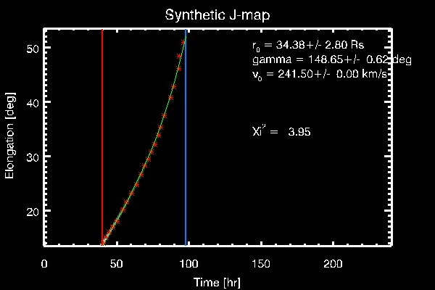
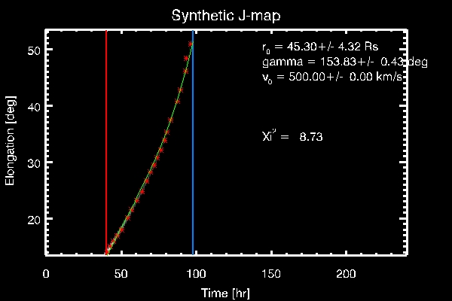
Case: plasma sphere at ≈241 km/s

Slide 21
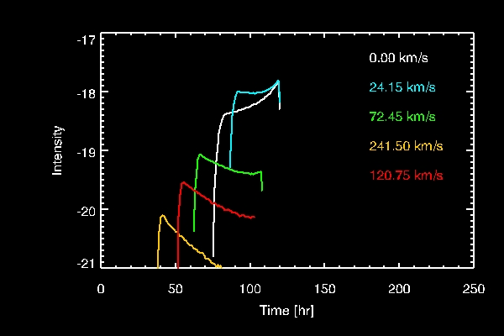
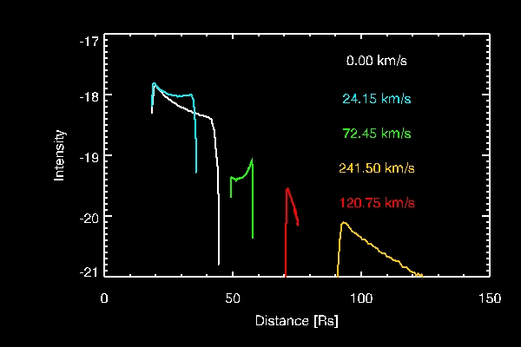
Intensity variation
← Intensity vs. time
Intensity vs. Distance PSP-plasma sphere →
In real observations we must take care of the variations of the background due to LoS changes, and variation of density distribution (e.g. CME)

Slide 22
Conclusions
We created some synthetic images of PSP/WISPR1 using Raytracing tools and considering the effective orbit of PSP
Fitting analysis of tracks in J-map can be used for the determination of the 3D position of coronal feature (still uncertain for features moving with constant speed. Maybe more data with WISPR-2)
Analysis of the intensity variations may be useful for the determinantion of distances from PSP
The fitting analysis should be adapted for features corotating with the Sun (e.g. streamers)

