Slide 1
Raytracing simulations for PSP/WISPR
Giuseppe Nisticò
30 Jan 2018

Slide 2
Main purpose: Modeling of coronal structures observed by WISPR to anticipate the future observations
Development of IDL routines from existing packages in SSW.
  SUNSPICE for the SPP trajectories, speed
  Raytracing tool for the solar corona
    https://hesperia.gsfc.nasa.gov/ssw/stereo/secchi/idl/scraytrace/doc/
    Several models are implemented in the packages (flux ropes, helmet streamers, ...)
  Simulating a WISPR FITS header from a a typical STEREO-HI one.

Slide 3
Steps followed to create a synthetic image:
1) Definition of the characteristics of WISPR image data (so far I did only for the camera 1 )
Image: 2048 x 1920 pixels
Elongation FoV: [40,40] deg
Offset: starting from 13.5 deg
Pixel size: 40 deg/ 2048 px = 0.019 deg = 70.31 arcs (at the Sun)
2) Orbital information from SUNSPICE
Getting the position of PSP from the SPICE kernel
cspice_furnsh, kernel
Defining the state of PSP
state = GET_SUNSPICE_LONLAT( t_utc, id, system = 'HEEQ', /meters, /degrees)
The ID for PSP is -180731
State is a vector containg the radial distance from the Sun, the heliographic longitude and latitude

Slide 4
3) Construction of a WCS structure
wcs = wcs_2d_simulate(wispr.pixel[0], wispr.pixel[1], cdelt = wispr.elongation_fov[0]/wispr.pixel[0], dsun_obs=state[0], date_obs=t_utc, hgln_obs=state[1], hglt_obs=state[2], cunit='deg‘, crval = [ wispr.offset[0] + 0.5*wispr.elongation_fov[0], 0.], projection='AZP' )
(This step could be skipped and one could immediately create a FITS header. However, I usually find easy working with WCS structures and defining a header with the next command)
4) Construction of the FITS header
hdr = wcs2fitshead(wcs, /struct)
This function creates a very basic header structure.
The header is later modified by adding some other tagnames typical of a STEREO-HI FITS header. I believe that rtraytracewcs works efficiently with a typical STEREO header.
5) Raytracing
rtraytracewcs,sbt,imsize=imsize,modelid=58,$
scchead=hdr,losnbp=500,losrange=[0,200], /frontinteg,$ modparam=param, nbthread=8,nbchunk=8

Slide 5

Simulation of a sphere of plasma seen from WISPR 1. The FoV of WISPR 1 has elongation between 13.5 and 53.3 deg. The sphere is kept steady at a position of ~15.15 solar radii, lat=0, and lon=270 deg in the HCI reference frame. The appearance of the sphere in the synthetic images occurs when it is in the cone-of-view (CoV)of the instrument (blued dashed lines in the left panel). The white dashed line is the central axis of the CoV; the blue dashed line is just a reference at 45 deg of elongation; the dashed red one another reference at 90 deg of elongation. The continuous red line is a reference in the Carrington coordinate system. Raytracing is performed along a LoS path of [-30,30] solar radii. Indeed, please note that the sphere appears in the synthetic image when it is behind the spacecraft.

Slide 6
To remove this effect, we added a keyword /frontinteg to the raytrace call, which allow us performing integration from the location of the observer along a path length Los=[0,50] in solar radii (LoS must be strictly positive when /frontinteg is used).

Slide 7
Now some tests with the sphere moving with constant speed.

Slide 10
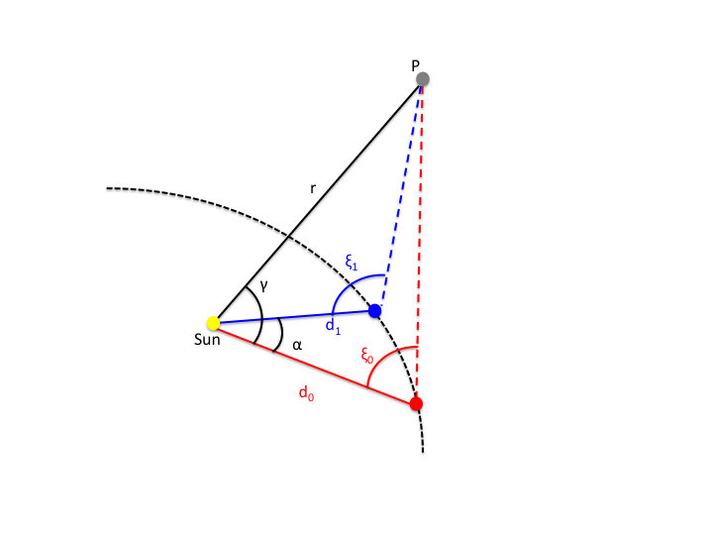
Problem:
Determination of the 3D position for a fixed point in space
Let us consider the triangles 0S(t₀)P and OS(t₁)P, and the law of sines
O
S(t₁)
Similar to what shown in Liu et al 2010, ApJ.
S(t₀)

Slide 11
Determination of the 3D position for a fixed point in space
After some algebra, one can find γ
Determination of the azimuthal angle γ (measured relatively to the position S(t₀))
This equivalent to the determination of the longitude.
Then, it is trivial to determine r from the previous equations.
O
S(t₁)
S(t₀)

Slide 12
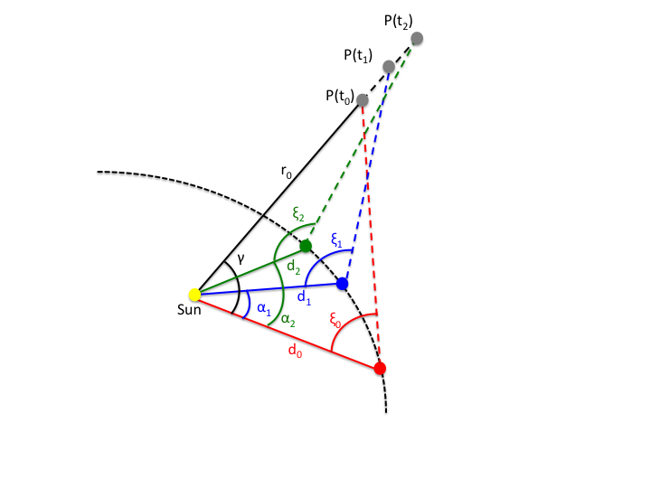
Determination of the 3D positions for a point moving radially with uniform speed
3 unknown variables: r₀,γ, v
Difficult to explicit the variables from this systems because of the presence of several sines. It needs to be solved numerically, or one could proceed by fitting the non-linear function

Slide 13
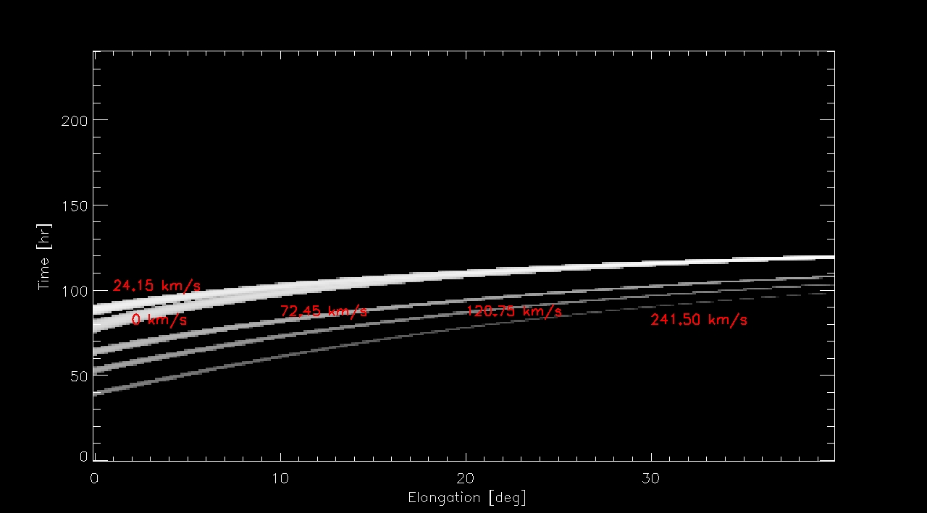
Example: j-map obtained from the tests with the plasma sphere
⁺
The function to be fitted would be this:

Slide 14
I think, I should linearise the sines in the previous equation and try to express the relation as
ξ_{i} = f ( t_{i,} r0, γ, v, α_{i}, d_{i})
Where t_{i} is the independent variable, ξ_{i} the dependent variable (e.g. the measurements from the j-maps); r₀, v, and γ the fitting parameters to be determined, and α_{i}, d_{i} the other (but known) variables (indeed we know the distance of PSP at different times and the separations angles).
I do not know of you have already faced and solved this issue.
Do you have any suggestion?

Slide 15
Raytracing MAS results
This is something that I started several months ago. The idea is to exploit the numerical outputs of MAS simulations, specifically density datacubes, and apply raytracing to produce a realistic view of the corona from WISPR.
If we have simulations running for a finite time interval (say 1 hr) we could see how turbulence process, instability etc. present in the simulations will appear in the WISPR FoV.
I have tried to do it with just a single density datacube (so at a fixed time) . The result is shown in the next third slide.
The main difficulty is to convert (“correctly”) the original density datacube from spherical coordinates into Cartesian, in order to apply raytracing. In addition, the spatial grid along the radial coordinate is not uniform, but finer for lower r. For raytracing, I would expect a uniform grid to give as input in the raytracing routines.
So, the movie that you will see is not correct. We do not see any nice coronal feature. I wrote a routine based on interpolation by myself to convert sph into Cart, but there are errors of course. Do you know any nice procedure in SSW to convert the datacube from spherical to Cartesian? I do not know if raytracing can be directly applied to a model in spherical coordinates, rather than Cartesian.

Slide 16
MAS modeling
A 3D datacube of “coronal” density was
downloaded from http://www.predsci.com/stereo/data_access.php
The file is named rho002.hdf.
The simulation ID for this datacube provided on the website is
“medium/hmi_masp_mas_std0201”. I do not know what some labels mean like “masp” or “std”. I imagine that “hmi” means that HMI magnetograms have been used as boundary condition for the simulation. The reference date should be Dec 14, 2016.
The datacube is a DOUBLE array with dimensions [201,151,257] which are in spherical coordinates: r, \theta, and \phi, respectively.
The grid spacing in r is not uniform: denser close to the Sun. The interval for the radial distance is ~0.99-30 solar radii.

Slide 17
A contour of density distribution on the plane r -\theta (\phi=0, and \phi=90 deg). A helmet streamer is elongated at 2.0 radians (114 deg, i.e. south hemisphere) in the left, while in the second it looks at 1.0 rad (≈57 deg) .
[The contours are in logarithmic scale, but I found very difficult to improve the contrast...]

Slide 18
In order to construct a synthetic white-light image from the density distribution by using the raytracing code, I have trasformed the datacube from spherical to cartesian coordinate (program attached). Below some example of images with cuts taken along X and Z, ideally through the Sun‘s centre.

Slide 20
Expanding flux rope system (from Paulett)
I sent to you a former version of this movie before Christmas if I remember, but I actually did some errors: the angular pixel size was not constant!!! This version should be correct, but I am still not happy, since I do not have the impression to fly through the flux rope system. I have to check.

Slide 21
Future plans:
Create a gallery of WISPR images with different models
Understand the advantages and of WISPR images
Understand how to correlated in-situ measurements data (e.g. density) with the features detected in WISPR images.

